Slide 1
Report
for Jul 2020 MP
BFX - AT100 & BFX-UH200
Date : 22 Jul 2020
Prepared by: Heng Ruan

Slide 2
Issue Description
20 Aug 2020, ALT customer complain [BFX-AT100] Jul 2020 Mass production issue.
Defect Total:
1. HDMI output noise (Critical ) : 1/500pcs (0.2%)
2. Carton box damaged (Major) 1/500pcs (0.2%)
3. Carton label damaged (Major) : 1/500pcs (0.2%)
4. Ethernet cable damaged (Major) : 1/500pcs (0.2%)
5. Ethernet cable not working (Major) : 2/500pcs (0.4%)
6. HDMI cable not working (Major) : 1/500pcs (0.2%)
7. Gift box printing is tilted (Minor) : Not counted (20%)

Slide 3
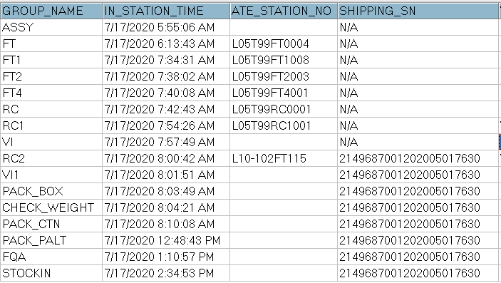
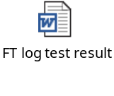
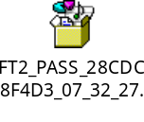

1. No HDMI output
Issue Description | Root Cause | Actions | Owner | Due Date | Status
Phenomenon: No HDMI output. Type: Critical Q’ty : 1/500pcs DR: 0.2% | Checked history. This unit was passed all stations smoothly. Waiting Visual inspection and X-Ray inspection when NG sample turn back Foxconn VN. 3. Checked test log information --> no issue found | Waiting NG sample ship back FXC for future analysis. | PE-Loc | TBD
Soc
DDR
EMMC
FIL1401 FIL1402
U1001

Slide 4
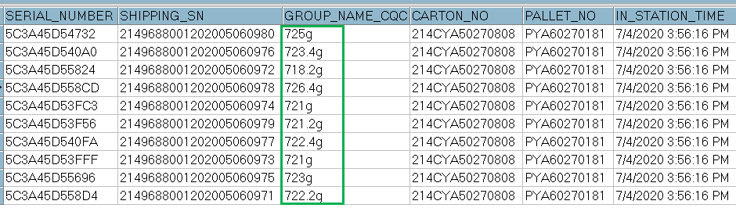


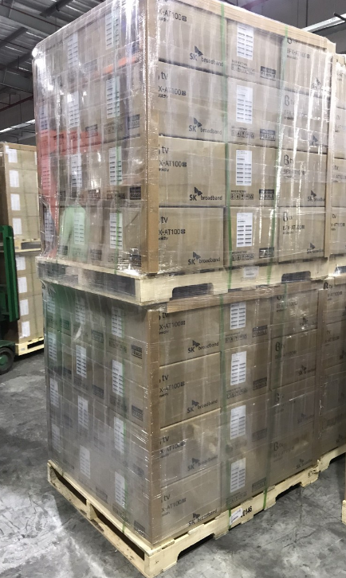
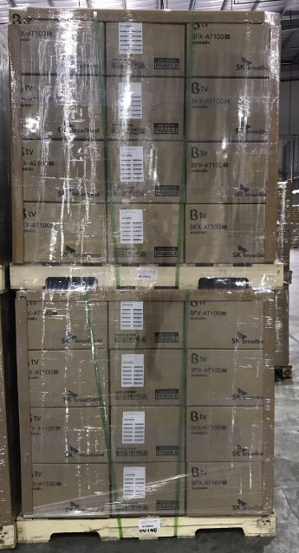
2. Carton box damaged
Issue Description | Root Cause | Actions | Owner | Due Date | Status
Carton Box Damaged Type: Major Q’ty : 1/500pcs DR: 0.2% | Check production data no found abnormal issue (pictures below) ➔ The Carton 214CYA50270808 is packing Full carton from SI line, packing follow normal process. 2. Re-check on pack Pallet and shipping area no find out the same issue. Root Cause : Carton Box damaged issue monitoring on check online production and shipping area. All pallet had check visual inspection before put in container for shipping. | Check 480 cartons on FG stock of BFX-UH200, No detect the same issue. Re-training OP on Kitting and FG stock arrange carton/pallet check careful. Add NG picture to SOP on Kitting station and FG stock area. CQA check this issue before put pallet into container. | CQA – Tu PQE-Hang IE: Huyen | 22-Aug-20 22 Aug 20 22-Aug-20
Check Normal packing before shipping, No reject Carton Box damaged.

Slide 5

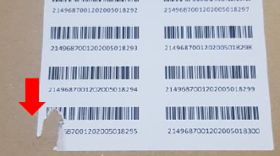
3. Carton Label damaged
Issue Description | Root Cause | Actions | Owner | Due Date | Status
Phenomenon: Carton Label damaged Type: Major Q’ty : 1/500pcs DR: 0.2% | Root cause: This issue maybe on FG stock when OP combine cartons into a full pallet. On production line, OP check all carton label after printer , then confirm no issue then paste on carton. On Kitting station, OP in kitting scan all carton labels for print out pallet label, If label was damaged will be re-print one new label. QC no find out label damaged when check pallet before shipping. Escaped cause : QC and OP on FG stock no find out label damaged when check pallet before shipping. | 1. Add NG picture to SOP online and Kitting and FG stock. 2. Training OP on FG stock by quality Alert issue. 3. Line leader often check and monitor all operators at all stations to make sure their operation complying with SOP. | IE: Huyen CQA:Tu PD: Dung | 22-Aug

Slide 6
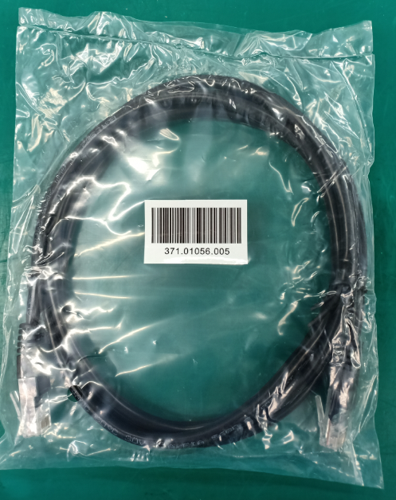
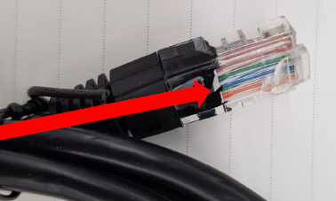


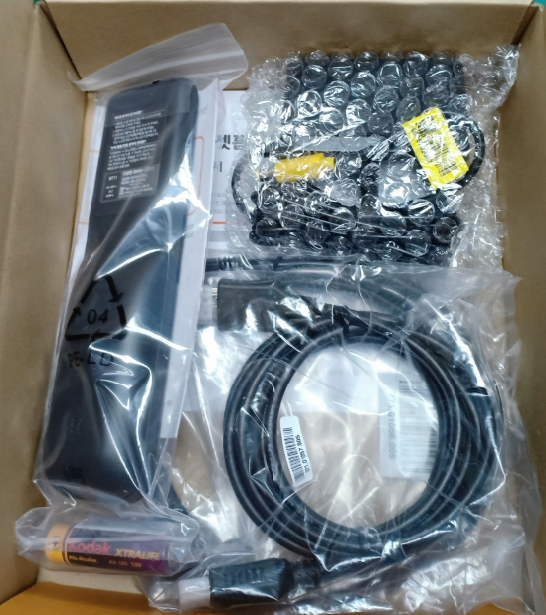

4. Ethernet cable damaged
Issue Description | Root Cause | Actions | Owner | Due Date | Status
Phenomenon: Ethernet cable damaged Type: Major Q’ty : 1/500pcs DR: 0.2% | Vendor root cause: The hook of Ethernet is broken is from incoming material issue. New coming Ethernet have PE bag. Escaped cause (at FXN): All accessory no test function online, just test OBA follow AQL 0.65. | FXN SQE was responsible for inform to vendor this issue, remark this issue on vendor side, Waiting sorting result from vendor. Waiting customer send back NG sample for further analysis and give out vendor’s action: FXN action: - Remark from IQC new coming material inspection this issue, - Showed NG sample and re-trained operator at put accessory station for checking requirement. - Line leader often check and monitor all operators at all stations to make sure their operating comply with SOP. | SQE-Khoa IQC: Long PD:Dung | 22-Aug

Slide 7
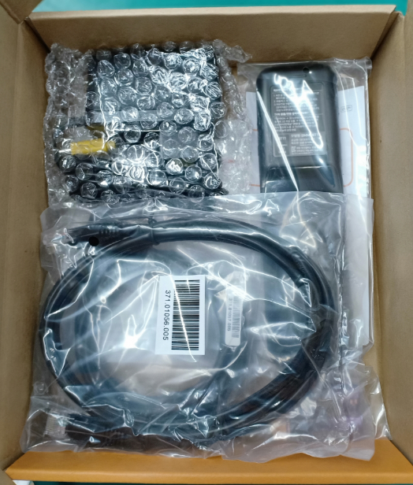
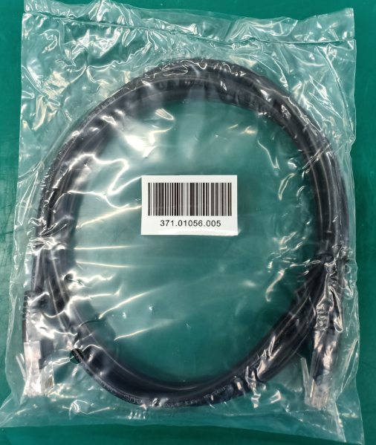
5. Ethernet cable not working
Issue Description | Root Cause | Actions | Owner | Due Date | Status
Phenomenon: Ethernet cable not working. Type: Major Q’ty : 2/500pcs DR: 0.4% | Vendor root cause: This issue is from incoming material issue. Escaped cause (at FXN): All accessory no test function online, just test OBA follow AQL 0.65. | FXN SQE was responsible for inform to vendor this issue, remark this issue on vendor side, Waiting sorting result from vendor. Waiting customer send back NG sample for further analysis and give out vendor’s action: FXN action: | SQE:Khoa | 21-Aug

Slide 8
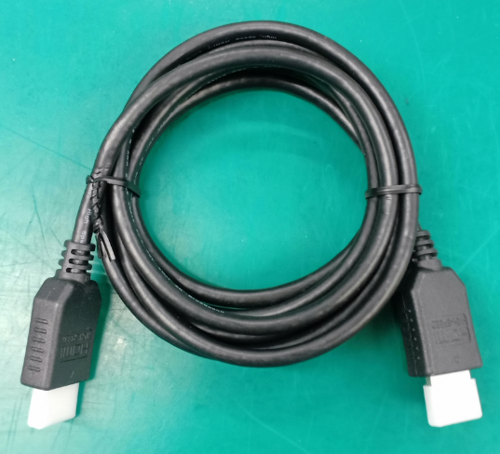
6. HDMI cable not working
Issue Description | Root Cause | Actions | Owner | Due Date | Status
Phenomenon: HDMI cable not working. Type: Major Q’ty : 1/500pcs DR: 0.2% | Vendor root cause: This issue is from incoming material issue. Escaped cause (at FXN): All accessory no test function online, just test OBA follow AQL 0.65. | FXN SQE was responsible for inform to vendor this issue, remark this issue on vendor side, Waiting sorting result from vendor. Waiting customer send back NG sample for further analysis and give out vendor’s action: FXN action: | SQE:Khoa | 21-Aug

Slide 9
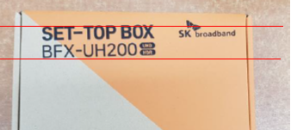
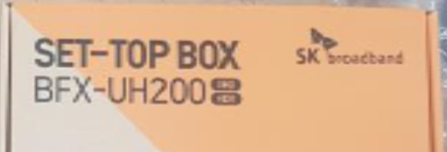


7. Gift box printing is tilted
Issue Description | Root Cause | Actions | Owner | Due Date | Status
Phenomenon: Gift-box printing is tilted Type: Minor Q’ty : Not counted DR: 20% | Occur Cause: Incoming material issue, had feedback to vendor for improved all Box printing for BFX-AT100 and BFX-UH200. Escape Cause: At Pack Box station and check weight, OP online is difficult to find the printing shifted issue. So escape this issue to customer side. | 1. SQE inform printing shifted on Box to vendor and request improved report from vendor. Inform to IQC for control incoming material inspection. 2. Remind and alarm the OP online and IPQC about the printing shifted gift-box issue online product. 3. Add NG Giftbox picture to SOP for OP remind this issue. | SQE:Khoa PD:Dung IE:Quyen | 25-Jul 25-Jul 28-Jul
Gift-box printing is tilted
Normal Box printing

Slide 10
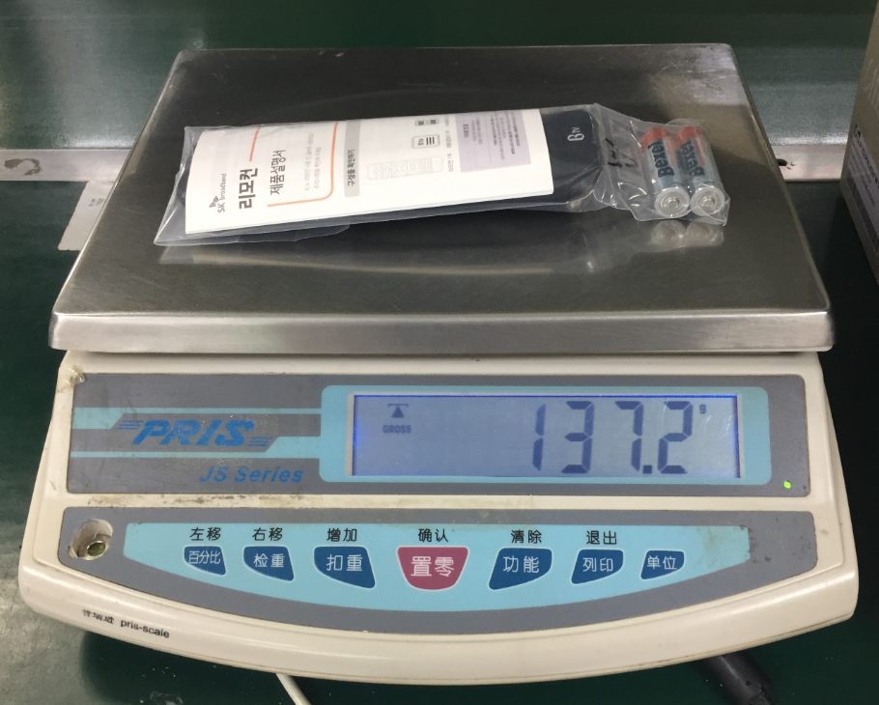
8. Missing RCU report
(1). 2149688001202003006676
(2). 2149688001202003017614
The box (1) was passed check_box weight station on 2020/04/16 8:06:51 AM with 724.6 g. (the weight on 2020/04/16: min 708.6g, max 734.6g)
Weight specification: 706.5 g ~736.5 g
The box (2) was passed check box weight station on 2020/04/18 10:16:44 PM (the boxes’s weight on 2020/04/18: min 710.6g, max 731.8g)
Weight specification: 705.6 g ~735.6 g
The weight of RCU (with batteries): 137.2g as p.1.
If missing RCU, the weight of box is around 550 g. It can not pass Check box weight station
p.1
1

Slide 11
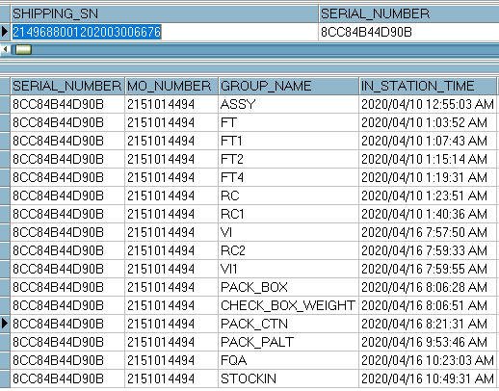
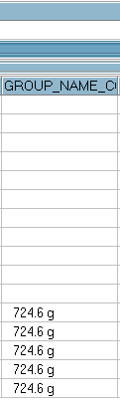
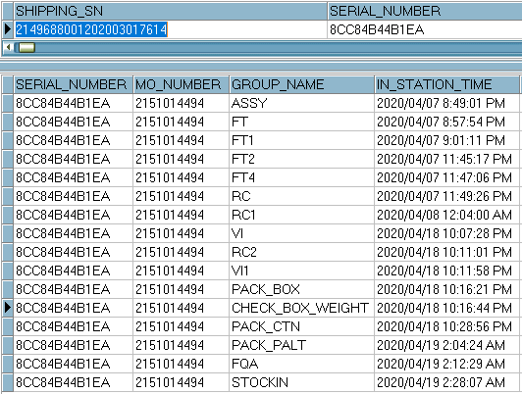
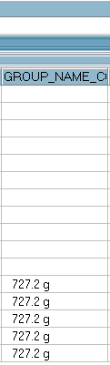
8. Missing RCU report
Checking production history of 2 boxes: 2 boxes passed through stations smoothly. No rework, no OBA test.
Conclusion:
- Check box weight station can cover issue of missing RCU.
History of GB was normally and smoothly by all stations.
Not through rework and OBA test station (means that these boxes were not opened after finishing pack box station)
1

